Slide 1
Chapter 13
Business Intelligence and Data Warehouses

Slide 2
Learning Objectives
In this chapter, you will learn:
How business intelligence provides a comprehensive business decision support framework
About business intelligence architecture, its evolution, and reporting styles
About the relationship and differences between operational data and decision support data
What a data warehouse is and how to prepare data for one

Slide 3
Learning Objectives
In this chapter, you will learn:
What star schemas are and how they are constructed
About data analytics
About online analytical processing (OLAP)
How SQL extensions are used to support OLAP-type data manipulations

Slide 4
Business Intelligence (BI)
Comprehensive, cohesive, integrated set of tools and processes
Captures, collects, integrates, stores, and analyzes data
Generates and presents information to support business decision making
Allows a business to transform:
Data into information
Information into knowledge
Knowledge into wisdom

Slide 5
Business Intelligence (BI)
Concepts, practices, tools and techniques to help business
Understand its core capabilities
Provide snapshots of the company situation
Identify key opportunities to create a competitive advantage
Provides a framework for
Collecting and storing operational data and aggregating it into decision support data
Analyzing decision support data and presenting generated information to end users to support business decisions
Making business decision which generates more data
Monitoring results to evaluate outcomes and predicting future outcomes with a high degree of accuracy

Slide 6
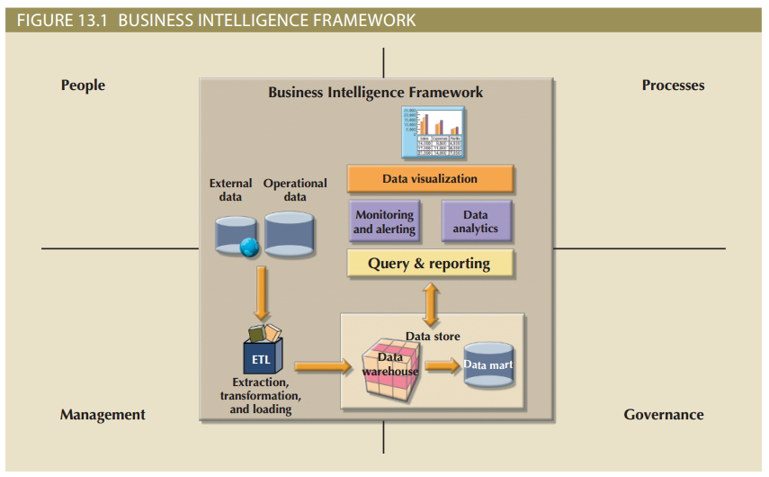
Figure 13.1 - Business Intelligence Framework

Slide 7
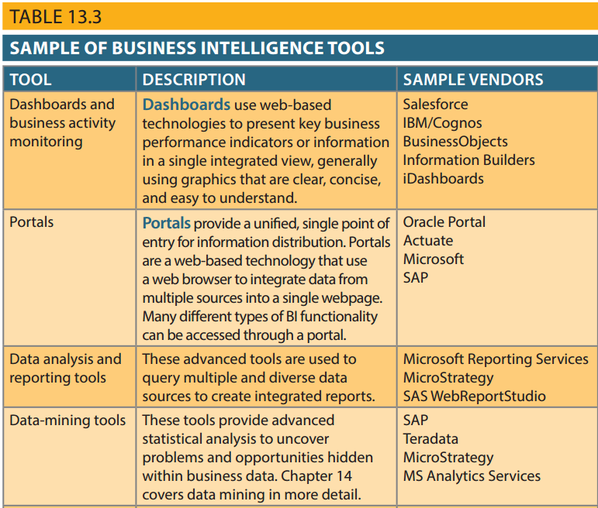
Table 13.3 – Sample of Business Intelligence Tools

Slide 8
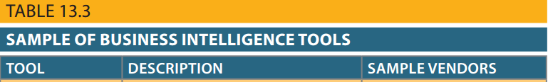
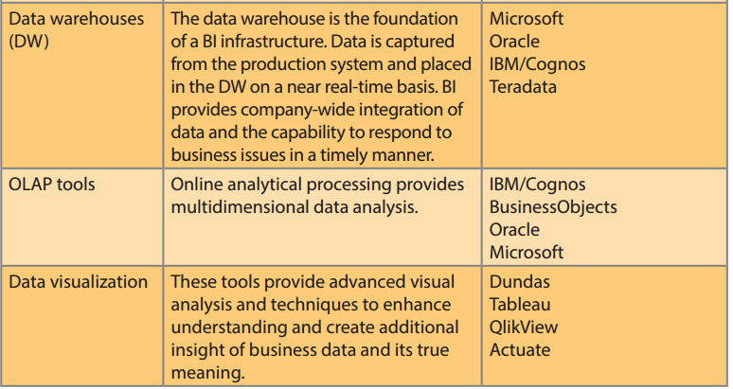
Table 13.3 – Sample of Business Intelligence Tools (cont’d)

Slide 9
Practices to Manage Data
Master data management (MDM): Collection of concepts, techniques, and processes for identification, definition, and management of data elements
Governance: Method of government for controlling business health and for consistent decision making
Key performance indicators (KPI): Numeric or scale-based measurements that assess company’s effectiveness in reaching its goals

Slide 10
Practices to Manage Data
Data visualization: Abstracting data to provide information in a visual format
Enhances the user’s ability to efficiently comprehend the meaning of the data
Techniques:
Pie charts and bar charts
Line graphs
Scatter plots
Gantt charts
Heat maps

Slide 11
Reporting Styles of a Modern BI System
Advanced reporting
Monitoring and alerting
Advanced data analytics

Slide 12
Business Intelligence Benefits
Improved decision making
Integrating architecture
Common user interface for data reporting and analysis
Common data repository fosters single version of company data
Improved organizational performance

Slide 13
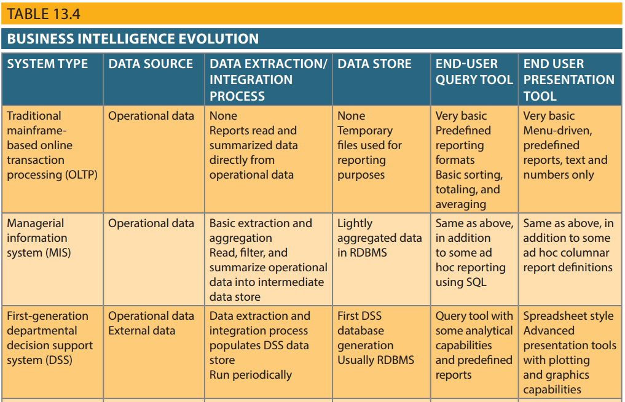
Table 13.4 - Business Intelligence Evolution

Slide 14
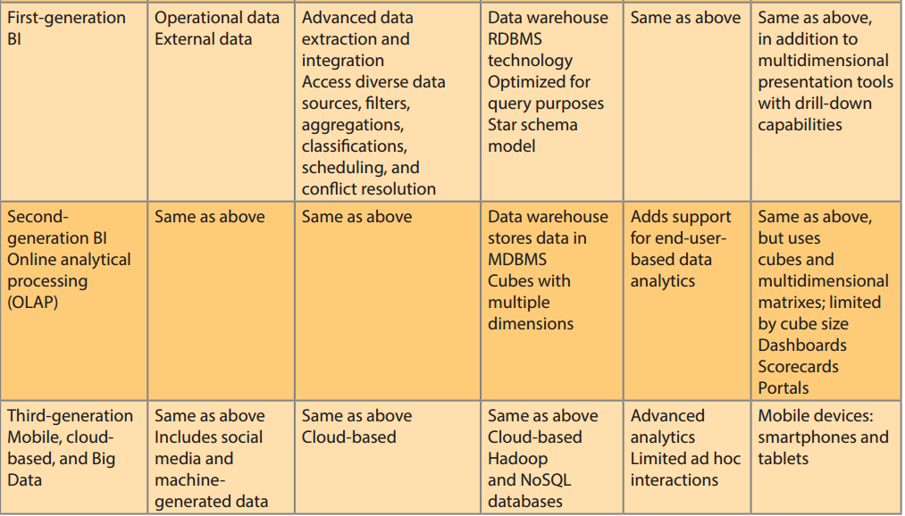
Table 13.4 - Business Intelligence Evolution (cont’d)

Slide 15
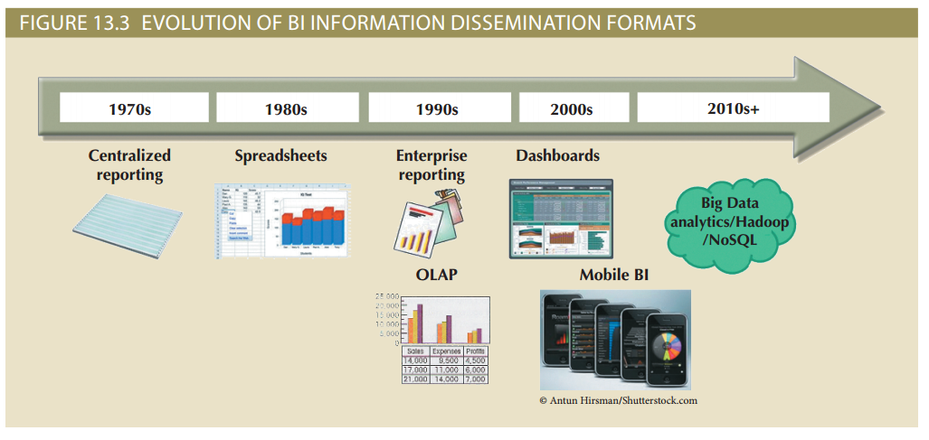
Figure 13.3 - Evolution of BI Information Dissemination Formats

Slide 16
Business Intelligence Technology Trends
Data storage improvements
Business intelligence appliances
Business intelligence as a service
Big Data analytics
Personal analytics

Slide 17
Decision Support Data
Effectiveness of BI depends on quality of data gathered at operational level
Operational data
Seldom well-suited for decision support tasks
Stored in relational database with highly normalized structures
Optimized to support transactions representing daily operations

Slide 18
Decision Support Data
Differ from operational data in:
Time span
Granularity
Drill down: Decomposing a data to a lower level
Roll up: Aggregating a data into a higher level
Dimensionality

Slide 19
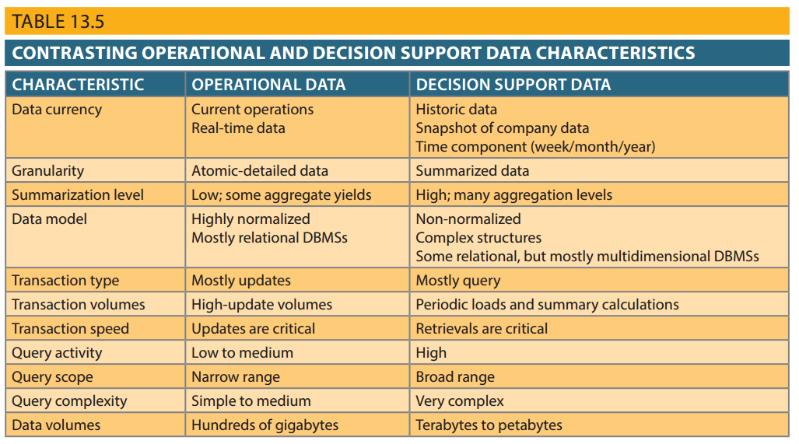
Table 13.5 - Contrasting Operational and Decision Support Data Characteristics

Slide 20
Decision Support Database Requirements
Database schema
Must support complex, non-normalized data representations
Data must be aggregated and summarized
Queries must be able to extract multidimensional time slices

Slide 21
Decision Support Database Requirements
Data extraction and loading
Allow batch and scheduled data extraction
Support different data sources and check for inconsistent data or data validation rules
Support advanced integration, aggregation, and classification
Database size should support
Very large databases (VLDBs)
Advanced storage technologies
Multiple-processor technologies

Slide 22
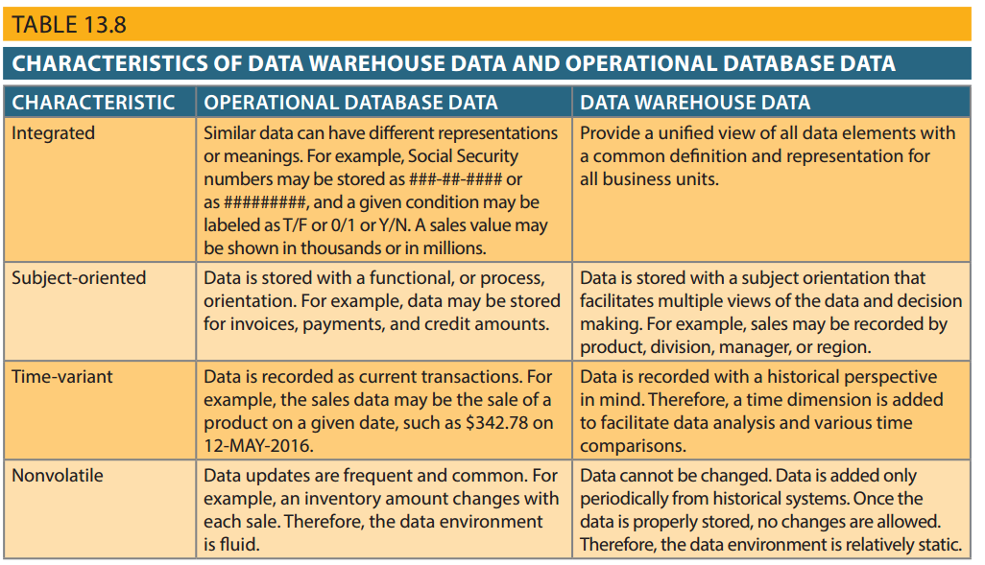
Table 13.8 - Characteristics of Data Warehouse Data and Operational Database Data

Slide 23
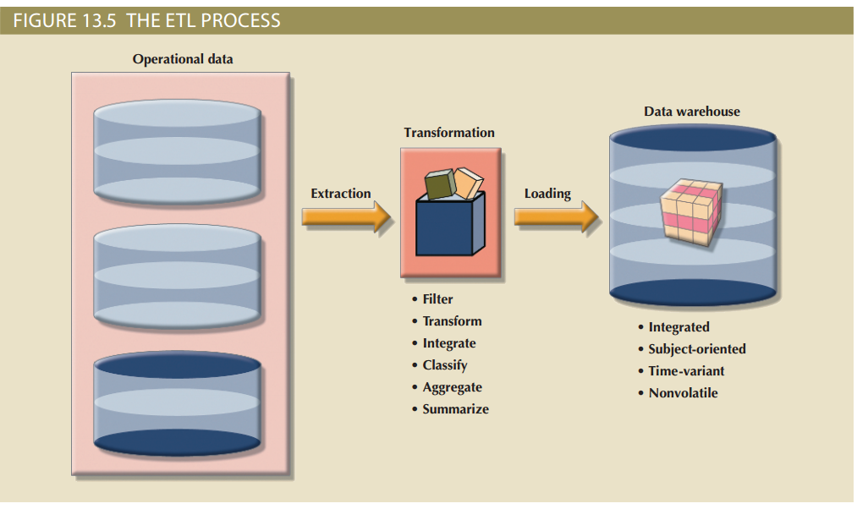
Figure 13.5 - The ETL Process
Cengage Learning © 2015

Slide 24
Data Marts
Small, single-subject data warehouse subset
Provide decision support to a small group of people
Benefits over data warehouses
Lower cost and shorter implementation time
Technologically advanced
Inevitable people issues

Slide 25
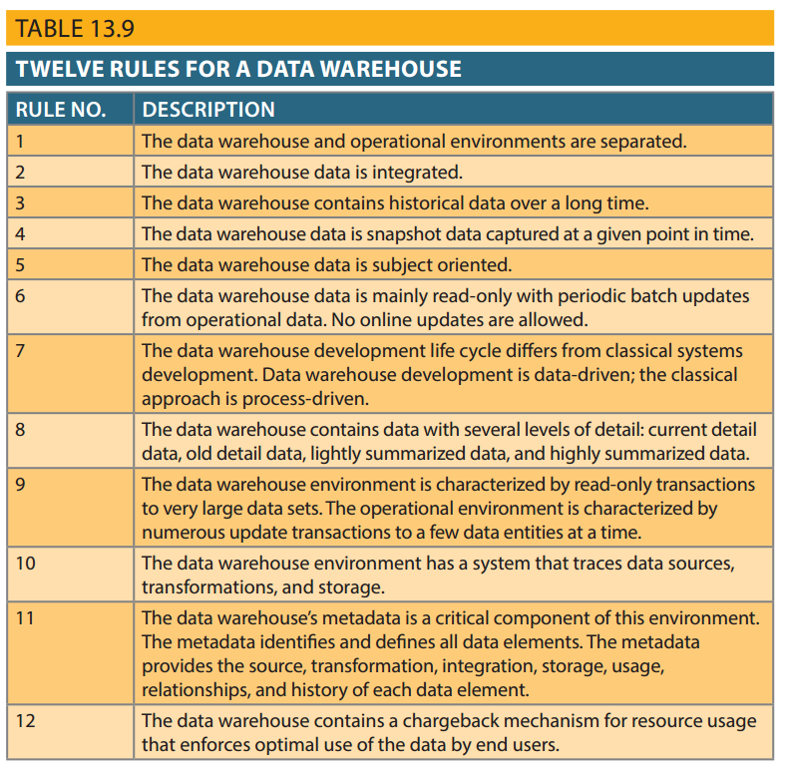
Table 13.9 - Twelve Rules for a Data Warehouse

Slide 26
Star Schema
Data-modeling technique
Maps multidimensional decision support data into a relational database
Creates the near equivalent of multidimensional database schema from existing relational database
Yields an easily implemented model for multidimensional data analysis

Slide 27
Components of Star Schemas
Facts
Dimensions
Attributes
Numeric values that represent a specific business aspect
Qualifying characteristics that provide additional perspectives to a given fact
Used to search, filter, and classify facts
Slice and dice: Ability to focus on slices of the data cube for more detailed analysis
Attribute hierarchies
Provides a top-down data organization

Slide 28
Star Schema Representation
Facts and dimensions represented by physical tables in data warehouse database
Many-to-one (M:1) relationship between fact table and each dimension table
Fact and dimension tables
Related by foreign keys
Subject to primary and foreign key constraints
Primary key of a fact table
Is a composite primary key because the fact table is related to many dimension tables
Always formed by combining the foreign keys pointing to the related dimension tables

Slide 29
Performance-Improving Techniques for the Star Schema
Normalizing dimensional tables
Snowflake schema: Dimension tables can have their own dimension tables
Maintaining multiple fact tables to represent different aggregation levels
Denormalizing fact tables

Slide 30
Performance-Improving Techniques for the Star Schema
Partitioning and replicating tables
Partitioning: Splits tables into subsets of rows or columns and places them close to customer location
Replication: Makes copy of table and places it in a different location
Periodicity: Provides information about the time span of the data stored in the table

Slide 31
Online Analytical Processing (OLAP)
Advanced data analysis environment that supports decision making, business modeling, and operations research
Characteristics:
Multidimensional data analysis techniques
Advanced database support
Easy-to-use end-user interfaces

Slide 32
Multidimensional Data Analysis Techniques
Data are processed and viewed as part of a multidimensional structure
Augmented by the following functions:
Advanced data presentation functions
Advanced data aggregation, consolidation, and classification functions
Advanced computational functions
Advanced data-modeling functions

Slide 33
Advanced Database Support
OLAP tools must have the following features to deliver efficient decision support:
Access to many different kinds of DBMSs, flat files, and internal and external data sources
Access to aggregated data warehouse data and operational database detail data
Advanced data navigation features
Rapid and consistent query response times
Ability to map end-user requests
Support for very large databases

Slide 34
Easy-to-Use End-User Interface
Proper implementation leads to simple navigation and accelerated decision making or data analysis
Advanced OLAP features are more useful when access is kept simple
Many interface features are borrowed from previous generations of data analysis tools

Slide 35
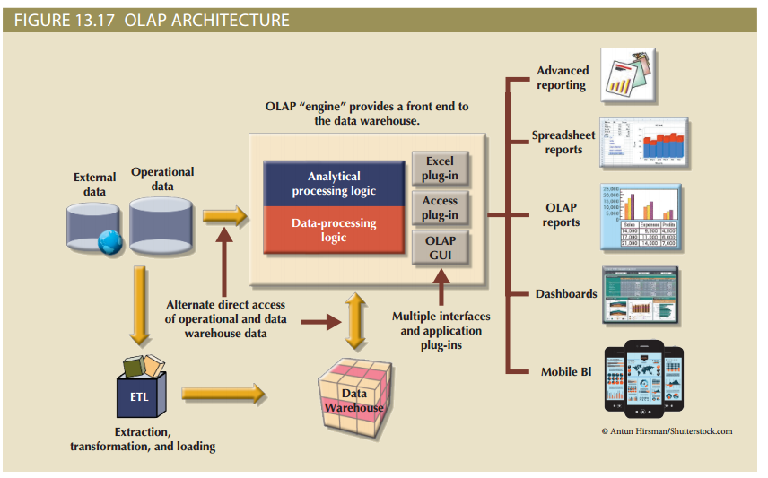
Figure 13.17 - OLAP Architecture

Slide 36
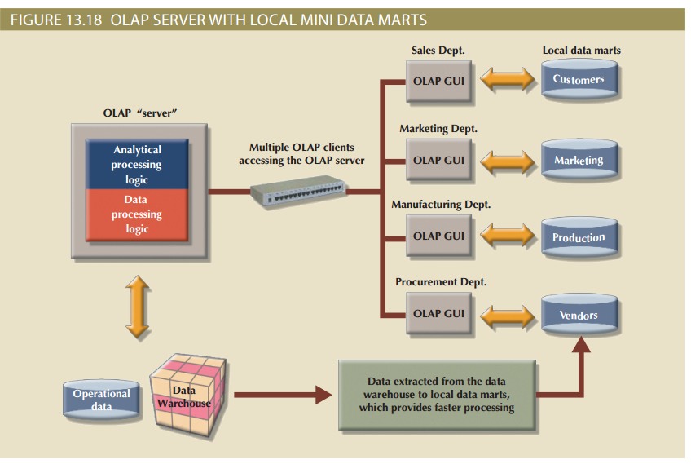
Figure 13.18 - OLAP Server with Local Mini Data Marts

Slide 37
Relational Online Analytical Processing (ROLAP)
Provides OLAP functionality using relational databases and familiar relational tools to store and analyze multidimensional data
Extensions added to traditional RDBMS technology
Multidimensional data schema support within the RDBMS
Data access language and query performance optimized for multidimensional data
Support for very large databases (VLDBs)

Slide 38
Multidimensional Online Analytical Processing (MOLAP)
Extends OLAP functionality to multidimensional database management systems (MDBMSs)
MDBMS: Uses proprietary techniques store data in matrix-like n-dimensional arrays
End users visualize stored data as a 3D data cube
Grow to n dimensions, becoming hypercubes
Held in memory in a cube cache to speed access
Sparsity: Measures the density of the data held in the data cube

Slide 39
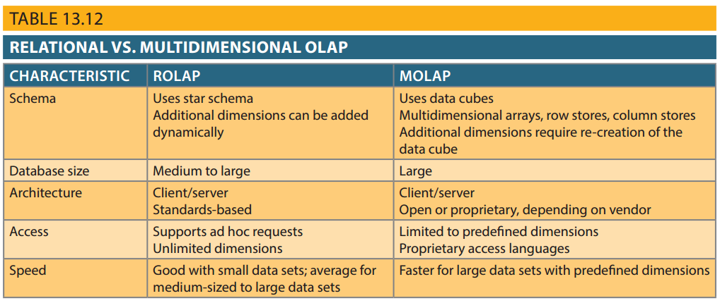
Table 13.12 - Relational vs. Multidimensional OLAP

Slide 40
SQL Extensions for OLAP
The ROLLUP extension
Used with GROUP BY clause to generate aggregates by different dimensions
Enables subtotal for each column listed except for the last one, which gets a grand total
Order of column list important
The CUBE extension
Used with GROUP BY clause to generate aggregates by the listed columns
Includes the last column

Slide 41
Materialized View
Dynamic table that contains SQL query command to generate rows and stores the actual rows
Created the first time query is run
Summary rows are stored in the table
Automatically updated when base tables are updated
Requires specified privileges

